Slide 1
MEMOIRE
Analyse de la littérature
Simon PENELLE
07/04/2025 - ??/08/2025

Slide 2
OBJECTIFS PREMIER: Faire le tour de la littérature sur le sujet:
Comprendre la base de données (GDSC) en détail
Documentation, Auteurs, objectifs, données présentes, accessibilité
Trouver des algorithmes de prédiction sur ces données
Comparer les méthodes de façon critique (inputs/résultats/méthodes)
Base de données similaires/ modèles similaires

Slide 3
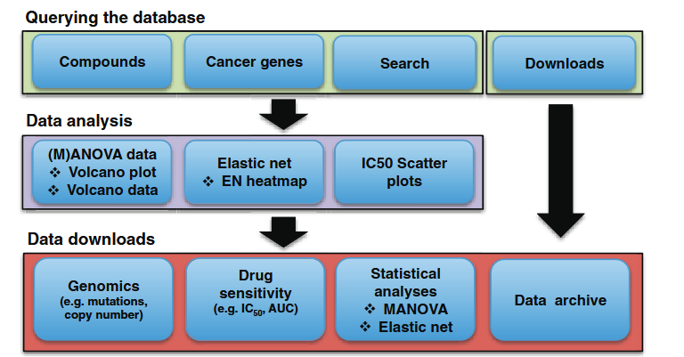
Genomics of Drug Sensitivity in Cancer (GDSC)
GDSC contains drug sensitivity data for almost 75 000 experiments, describing response to 138 anticancer drugs across almost 700 cancer cell lines representing 73 169 cell line–drug interactions. (in 2012)
cell line drug sensitivity data are integrated with genomic datasets (Catalogue of Somatic Mutations in Cancer): somatic mutations in cancer genes, gene amplification and deletion, tissue type and transcriptional data
all datasets are fully downloadable
OBJECTIVE: database is designed to facilitate an increased understanding of the molecular features that influence drug response in cancer cells and which will enable the design of improved cancer therapies. GDSC holds and annotates large datasets on drug sensitivity in cancer cells and links these data to detailed genomic in-formation to facilitate the discovery of molecular biomarkers of drug response
The majority of new drugs failing during clinical trials (estimated to be between an 80–95% failure rate) due to lack of efficacy or unacceptable toxicity
A schematic representation of the GDSC database structure and content.
Genomics of Drug Sensitivity in Cancer (GDSC): a resource for therapeutic biomarker discovery in cancer cells (Wanjuan Yang, 2012, Nucleic Acids Research).

Slide 4
Genomics of Drug Sensitivity in Cancer (GDSC)
The GDSC database is based on three types of datasets:
- Cell line drug sensitivity data :
Drugs are compound selected via high-troughput screening on over 1000 cancer lines. Composed of Clinical compounds, approved drugs, early stage drugs, targeted agents or cytotoxic chemotherapeutics.
Cell line drug sensitivity is measured using fluorescence- based cell viability assays following 72 h of drug treat- ment. Dose–response curves are fitted to fluorescence signal intensities over nine drug concentrations (2-fold dilution series) to derive a multi-parameter signature of drug response. Values reported on the website include the half maximal inhibitory concentration (IC50 ), the slope of the dose–response curve and the area under the curve for each experiment.
- Genomic datasets for cell lines: The project uses over 1,000 cancer cell lines that represent many types of adult and childhood cancers, from various tissues (like skin, blood, muscle, etc.). The genomic datasets currently available for each cell line include information on somatic mutations in 75 cancer genes, genome wide gene copy number for amplification and deletion, targeted screening for seven gene rearrangements, markers of microsatellite instability, tissue type and transcriptional data.
Catalogue of SomaticMutations in Cancer (COSMIC) database: a comprehensive freely available resource for the annotation and presentation of somatic mutations in cancer
- Analysis of genomic features of drug sensitivity:
A multivariate analysis of variance (MANOVA) is used to correlate drug sensitivity (IC50 values and slope of the dose–response curve) with genomic alterations in cancer including point mutations, amplifications and deletions of common cancer genes, cancer gene rearrangements and microsatellite instability
elastic net regression, a penalized linear modelling technique, to identify multiple interacting genomic features influencing each drug response including all of those used in the MANOVA and also incorporate genome-wide transcriptional profiles and tissue type

Slide 5
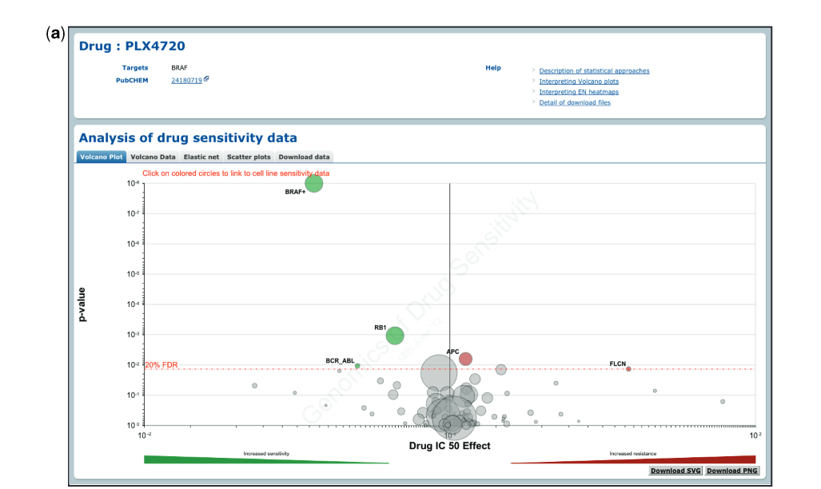
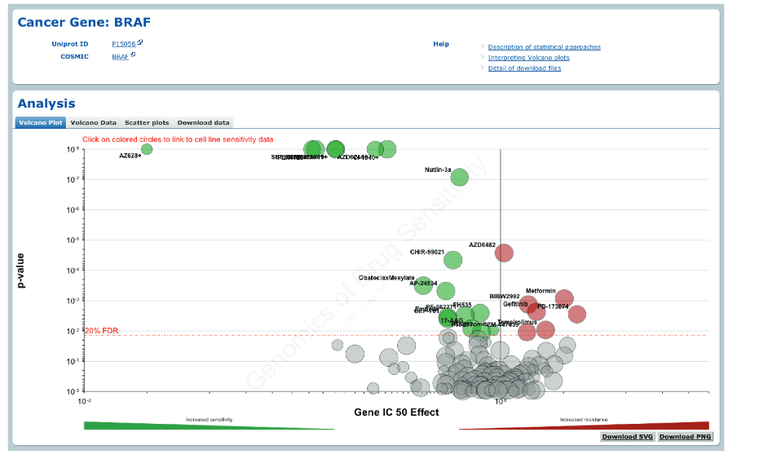
Accessibilité:
Browsing by ‘Compounds’ displays a list of drug names together with their associated synonyms, putative therapeutic target(s), the number of cell lines screened for each drug (sample size) and date of the most recent data update , a link to the PUBCHEM database of chemical structures is provided. By clicking a specific drug name, users enter the individual drug page where drug sensitivity and genomic correlation data are presented.
The ‘Cancer Genes’ section lists cancer-related genes by their HUGO-approved names, with direct links to COSMIC for mutation info and UniProt for protein data. Clicking a gene name opens a page showing its drug sensitivity and genomic correlation data.
It is also possible to query the database using a ‘Search’ function. The ‘Search’ box accepts queries based on compound (including synonyms), cancer gene or cell line name.
A volcano plot, representation of MANOVA results showing the magnitude (x-axis) and significance (P-value, log scale on inverted axis) for each cancer gene
association.
Benjamini–Hochberg multiple testing correction for significance (red line)
A volcano plot representation shows results of the MANOVA analysis for drug sensitivity associated with one cancer gene/mutations.

Slide 6
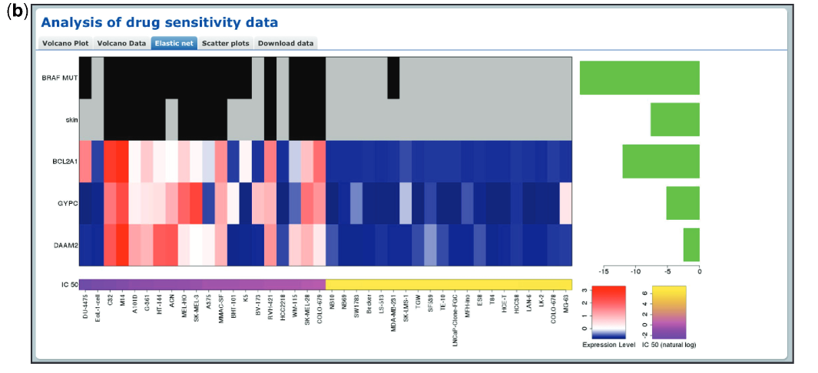
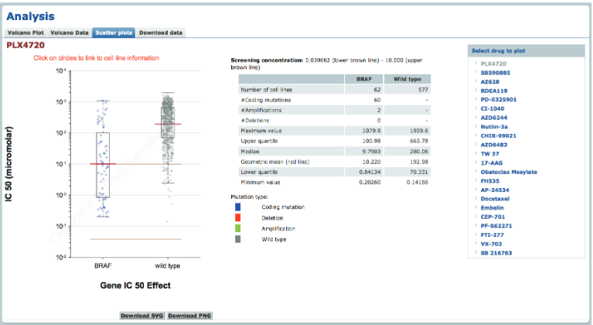
Elastic net analysis of genomic features associated with sensitivity to PLX4720 drug. Features with
negative effect size are associated with drug sensitivity and features with positive effect size are associated with drug resistance (all features are negative in this example). Mutation and tissue features are at the top of the heatmap to represent the presence (black) or absence (grey) of a mutation/tissue subtype. Below this are gene expression and copy number features with blue corresponding to lower expression or copy number, and red to indicate higher expression or copy number.
A maximum of 10 significant features associated with drug response are shown. These may include tissue type, mutations in cancer genes, expression levels and gene copy number. Each graphic contains three elements: a barplot of effect size for significant features (right-handside), a heatmap of genomic features (central panel) and a second heatmap of IC 50 values for the 20 least and most sensitive cell lines (bottom)
The ‘Scatter plots’ tab shows a plot of cell line IC 50 values to a drug. IC 50 values are split into two populations according to a cell lines mutational status for a given gene that is significantly associated with the drug response. Each circle represents the IC50 value for an individual cell line plotted on a logarithmic scale and the red line is the geometric mean of the population. Cell lines are colour coded to indicate whether the mutation is a coding mutation detected
by sequencing, or an amplification or deletion detected by copy number analysis.

Slide 7
Download data:
the volcano and scatter plots are downloadable as either .png or .svg files. In addition, the raw data are available to download in either .csv or .xlsx format. As described below, it is possible to download the data for a specific drug or gene on their associated pages, or to download the data from all of our analyses in a series of large spreadsheets.
Downloadable files include (i) cell line tissue type, drug sensitivity and genomic data used for the MANOVA; (ii) the MANOVA results for all compounds; (iii) A tissue-specific ANOVA to examine the effect of tissue type on drug response; (iv) the elastic net results for all compounds; (v) cell line genomic and transcriptional data used for elastic net analysis and (vi) a continuously updated list of cancer cell lines in our collection.

Slide 8
DATABASE DOCUMENTATION
The database is composed of 2 sets of data GDSC1 and GDSC2
GDSC1 has 970 cell lines and 403 compounds for a total of 333292 IC50s with data from 2009 to 2015
GDSC2 contains more recent data and has 969 cell lines and 297 compounds for a total of 243466 IC50s
GDSC1 - negative controls were cell treatments with media alone, and the positive controls were blank wells with media but no cells
GDSC2 - the negative controls are treatments of the cell with media + DMSO (the compound vehicle in most cases), while the positive controls are again blanks.
Dose-response curves are fitted using the non-linear mixed effects model of Vis et al. , incorporated in the gdscIC50 package. Biomarker discovery uses the GDSCTools python package of Cokelaer et al. to run ANOVA for each dataset independently.
Curve fitting
Fluorescence intensity data from screening plates for each dose response curve is fitted using a multi-level fixed effect model (PubMed ID: 27180993). The viability of the concentration dilution series is assumed to be sigmoidal, the classical dose-response S-shape. This function is fitted to all of the cell line - compound combinations screened. In the multilevel mixed effect model used here, two parameters are used to describe the sigmoidal curve. However, instead of fitting each dose-response series in isolation, the complete set with all combinations of cell lines - compounds screened, is fitted simultaneously.

Slide 9
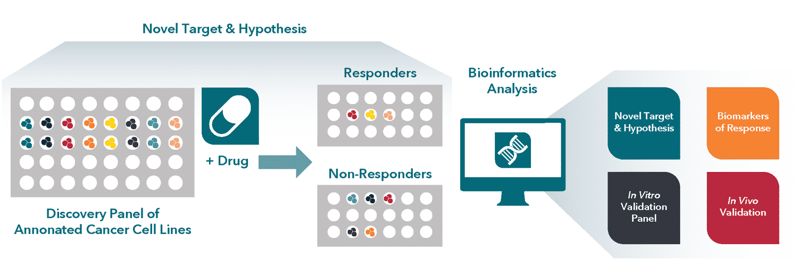
Cell line: context and definitions
Over 1,000 adult and childhood cancers cell lines, categorized using TCGA tumor type descriptions, and linked by unique COSMIC IDs.
Cell Culture: Cell lines were grown in RPMI or DMEM/F12 media with 5–10% FBS and antibiotics, under standardized conditions (37°C, 5% CO₂) to support consistency in drug sensitivity assays and high-throughput screening.
Identity of cell lines was confirmed using a 92-SNP panel and 16-STR testing

Slide 10
Database features
Cell lines have been comprehensively genetically characterised including:
1. Cancer genes (CG) (were identified using three algorithms: MutSigCV, OncodriveFM, and OncodriveCLUST — resulting in 461 unique pan-cancer genes, plus 9 more tumor suppressor genes)
2. Copy number alterations (RACS) (Median 19 RACSs per tumor type - 851 cancer-specific RACSs: 286 amplifications, 565 deletions - 38% of RACSs included known driver genes (like EGFR, MYC, CDKN2A), 62% did not.)
3. DNA methylation (iCpGs) (6,166 tumor samples across 21 cancer types - 378 iCpGs (informative CpG sites), showing distinct methylation patterns in at least one cancer type.)
4. Gene fusions (targeted PCR sequencing or split probe FISH analysis)
5. Microsatellite Instability (markers BAT25, BAT26, D5S346, D2S123 and D17S250)

Slide 11
Statistical analysis
map of the oncogenic aberrations in >11,000 human tumors (data from TCGA, ICGC, …) including 1) genes whose mutation patterns in whole exome sequencing (WES) data are consistent with positive selection; and 2) focal recurrently aberrant copy number segments from SNP6 array profiles (RACSs)
Driver mutations in cancer genes were detected by combining the outputs of three algorithms: MutSigCV, OncodriveFM and OncodriveCLUST (Gonzalez-Perez and Lopez-Bigas, 2012; Lawrence et al., 2013; Rubio-Perez et al., 2015; Tamborero et al., 2013a).
The detection of RACSs was performed using the ADMIRE algorithm (Chapman et al., 2011; Mok et al., 2009; Shaw et al., 2013; van Dyk et al., 2013) RACs were filtered to require segments to include at least one protein coding or antisense gene, but no more than 100.
Feature Selection: For pan-cancer analysis, all cancer-specific features present in at least 3 cell lines were included. Identical patterns were merged, resulting in 667 unique features across 988 cell lines.
A non-linear mixed effect model fits a sigmoid (S-shaped) curve to the drug dose-response data to estimate IC50 and AUC values. The model error can be estimated by the root mean squared error (RMSE) which is indicative of how far the model approximation deviates from the measured observations. Where the RMSE is > 0.3 the fit is considered poor and the results have been filtered from further analysis.
Associations between gene features and drug responses were assessed using effect sizes (Cohen’s d and Glass’s delta), p-values, and other statistical scores. Benjamini–Hochberg correction was applied to p-values to control for false discoveries. Significance was determined with a p-value threshold of 10⁻³ and a false discovery rate (FDR) threshold of 25%.
We have performed two types of analyses on our drug sensitivity and genomic datasets. A pan-cancer analysis correlates drug sensitivity for cell lines from all cancer types with genomic features identified from the analysis of patient tumours across multiple different cancer types. A cancer-specific analysis correlates drug sensitivity for cancer cell lines of the specified cancer type with genomic features identified in patients from the designated cancer type. The cancer types are those described by The Cancer Genome Atlas (TCGA).
Remarks:
Analysis realized in vitro on screened compounds and cell lines
Associations with large-effect size and high statistical significance should be prioritised.

Slide 12
Volcano plot
Volcano plots can be gene-specific or drug-specific;
In each volcano plot three pieces of data are represented:
x-axis:
The magnitude of the effect that each genetic events has on cell lines IC50 values in response to a drug. The effect size is proportional to the difference in
mean IC50 between wild-type and mutant cell lines. Numbers less than 0 indicate drug sensitivity, numbers greater than 0 indicate drug resistance.
y-axis:
The p-value from the ANOVA of a drug-gene interaction on an inverted log10 scale. For clarity the axis is capped at p = 1 x 10-8 and a plus sign (+)
next to a circle indicates that the p-value is smaller than this threshold.
Size of each circle:
The number of cell lines contributing to the analysis for a given genetic feature or drug.
Color
Cancer features associated with statistically significant sensitizing or resistance effects (20% FDR) are coloured green and red, respectively.
By hovering over each circle the following information is provided: genetic feature, sample size (number of cell lines with feature screened),
effect size and p-value. Non-signficant associations are grey.

Slide 13
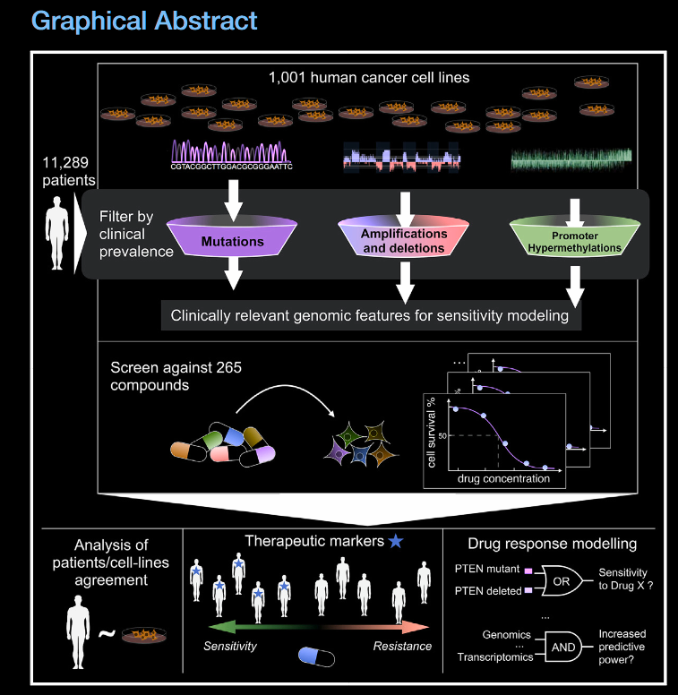
A Landscape of Pharmacogenomic Interactions in Cancer Francesco Iorio, Theo A. Knijnenburg, Daniel J. Vis (2016, Cell)
Highlights of article:
integrate heterogeneous molecular data of 11,289 tumors from 29 organs and 1,001 cell lines
measure the response of 1,001 cancer cell lines to 265 anti-cancer drugs
uncover numerous oncogenic aberrations that sensitize to an anti-cancer drug
This study forms a resource to identify therapeutic options for cancer sub-populations

Slide 14
analyzed somatic mutations, copy number alterations, and hypermethylation across a total of 11,289 tumor samples from 29 tumor types to define a clinically relevant catalog of recurrent mutated cancer genes, focal amplifications/ deletions, and methylated gene promoters. These oncogenic alterations were investigated as possible predictors of differential drug sensitivity across 1,001 cancer cell lines

Slide 15
Features determination
CG:

